Slide 1
Fox Valley SHRM Intersection of our Lived and Learned Experiences; Fostering Authentic Relationships
Alonzo Kelly, MPA, MHRLR, MBA
CEO
Kelly Leadership Group, LLC

Slide 2
Psychologically Safe Environments
Accountability
Courage
Humility
Empowerment

Slide 3
6 Modalities of Learning
Read
Write
Listen
Speak
Think
Role Play

Slide 4
Loving Mother?

Slide 5
I Present As…
Black male born in Detroit, MI and raised in Rural Wisconsin (Nigrescence Theory; Lived Experience)
Decade in foster care system; 9 different ‘homes’
Seminary Indoctrinated HS Thinking (Formal Education)
BSBA (Accounting), MPA (Public Administration), MHRLR (Human Resources/Labor Relations), MBA (Business Administration), PhD Candidate (Multidisciplinary Human Services), DBA Student (Business Administration); (Learned Experience)
Father (18yr Daughter, 13 yr Son, 3 yr Son); Lived Experience
Business Owner (Kelly Leadership Group; alonzokelly.com)
Absolutely Confused on the ways of Community (Emotional Intelligence)

Slide 7
Define Critical Thinking
Thinking about my thinking while thinking to be a better thinker.

Slide 8
Time and Distance

Slide 9
Psychology Experiment

Slide 10
SOCIAL RESPONSIBILITY

Slide 11
SOCIAL ACCOUNTABILITY

Slide 13
Intersection
Lived Experience (How you are raised)
Learned Experience (What you understand through maturity)
Formal Education (What you ‘learned’ in school)
Emotional Intelligence (ability to critically think through emotions)

Slide 14
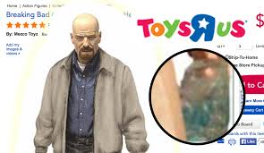

Slide 15
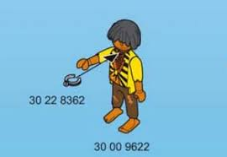
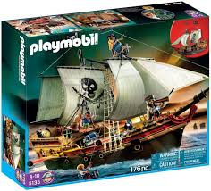

Slide 19
Contact Information
alonzo@kellyleadershipgroup.com
www.alonzokelly.com
Facebook: KellyLeadershipGroup
Twitter: @KLGLLC
LinkedIn: Alonzo Kelly
YouTube: Kelly Leadership Group
414-688-9642
THANK YOU FOR YOUR LEADERSHIP!

