Slide 1
Non-traditional benefits you should consider for your company
Presented to:
February 16, 2021
Jay N. Scott, CHC
SVP, Employee Benefits Practice Group Leader
© 2020 USI Insurance Services. All rights reserved..

Slide 2
Learning Objectives
By the end of this session you should be able to:
Understand the definition of “non-traditional benefits”
Consider which non-traditional benefits are most attractive to your employees
Learn the various legal, social, and ethical implications of non-traditional benefits

Slide 3
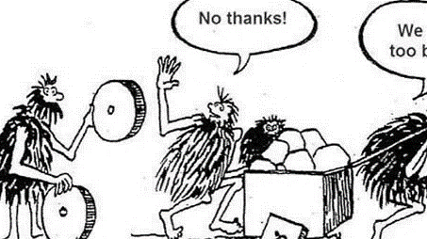
Image source: https://neosystems.com/death-spiral-mr-laut-not-if-we-make-these-choices/
Notes:
This slides is geared to get you in the mindset for thinking about new things. Failure to try new things can have bad results, like being late to the game (think Polaroid). In our own roles and benefits and HR leaders, failure to examine and try out new benefits can result in difficulties recruiting and retaining employees, if employees think they can find the benefits they want elsewhere.

Slide 4
What is a Non-Traditional Benefit?
Non-Traditional: Not following or conforming to tradition; not adhering to past practices or conventions; take learning beyond traditional boundaries
Fun Fact – the first time the word non-traditional was found in print was in 1915. This was the same year as stink bomb, small-time and occupational therapy.
Definition has changed over time – however, we do come “Back to the Future” often
Example: Original insurance pricing was no network and a “Fee for Service” structure – now the same thing is being talked about, its just called Reference Based Pricing
Traditional benefits have generally included at least Life Insurance and Medical/Rx Insurance. This list has expanded over time to include many other Employer Sponsored benefits, including dental, vision, disability, etc.
What is the definition of “Employer Sponsored?”

Slide 5
Non-Traditional Benefits
Dependent Care Benefits
Remote Work
PTO
Flexible Scheduling
Health Plans:
Alternative Health Access
Care Management / Claims Advocacy
Trends in High Deductible Health Plans
Aggressive Cost-Saving Measures

Slide 6
Types of Dependent Care Benefits
Dependent Care FSA: Employee puts aside pre-tax dollars to pay for dependent care expenses, usually up to a cap of $5,000
Dependent Care FSAs are subject to cafeteria plan mid-year election change rules, which can limit their flexibility…but the IRS has made exceptions for Dependent Care FSA changes during 2020
Even within the mid-year election change rules, Dependent Care FSA elections can change frequently when the need for care changes (e.g., during a pandemic!)
Dependent Care FSAs are “use it or lose it” – Dependent Care FSA dollars remaining at the end of the plan year (and grace period, if any) are forfeited
If employees are at risk of forfeiting their Dependent Care FSA dollars, they could use those dollars for:
Before/after school care, if available
In-home care that meets IRS requirements
Day camp programs that are not primarily educational in nature
Traps for the Unwary:
Because higher income employees typically contribute more to their Dependent Care FSAs than other employees, Dependent Care FSAs often fail nondiscrimination testing, esp. in smaller companies
Some vendors will treat an employee who stops contributing due to a change in their care needs as no longer “participating” in the FSA, meaning that during the period of non-participation the employee can’t access their Dependent Care FSA dollars – employees sometimes can avoid this by reducing contributions to $1 per pay period
Find out how your Dependent Care FSA vendor handles this situation so you can appropriately advise employees
Notes:
IRS child care requirements – care provider is not the employee’s tax dependent or spouse/co-parent; care is necessary for employee to be gainfully employed

Slide 7
Types of Dependent Care Benefits
Employer-Subsidized Daycare: Employer contributes towards the cost of employee’s dependent care expenses
Subsidies typically provided for “emergency” daycare situations; usually capped in amount
In a pandemic, employers could contribute towards the cost of in-home care providers for remote employees
On-Site Daycare: Employer hires daycare providers to provide care to employees’ children in or near the workplace
Employer hires individual daycare providers or engages an existing agency to provide care to employees’ children, usually in or very close to workplace
Employer that directly hires individual providers without engaging an existing agency should review state daycare licensing requirements before offering on-site daycare
Trap for the Unwary: Employer payments towards employees’ daycare expenses or on-site daycares count towards the same $5,000 tax-free limit that applies to Dependent Care FSAs.
Example: Employee’s child is in the employer’s on-site daycare which is free of charge to the employee but has an annual fair market value of $12,000; employee is taxed on $7,000 of the excess dependent care benefit above $5,000.
Example: Employee contributes $4,500 to his Dependent Care FSA but also receives back-up daycare benefits from his employer that have a fair market value of $1,000. Employee is taxed on $500 of the excess dependent care benefit above $5,000.
But, employers may be eligible for special deductions if they invest in a workplace day care center
Notes:
IRS child care requirements – care provider is not the employee’s tax dependent or spouse/co-parent; care is necessary for employee to be gainfully employed

Slide 8
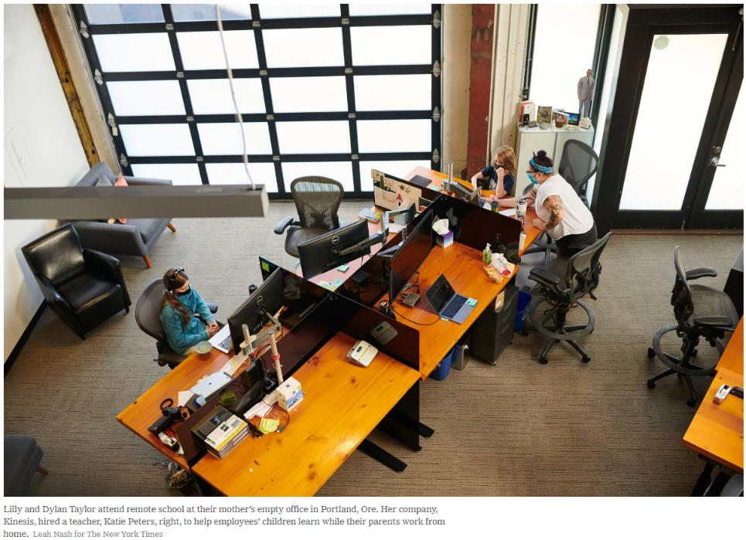
Types of Dependent Care Benefits

Slide 9
Types of Dependent Care Benefits
Bring Your Child to Work
Traditionally this benefit has only been offered to employees of daycares and certain other child-serving professions
The pandemic has more employers asking about offering this benefit
Obvious risks: Injuries; property damage; loss of productivity due to supervising children on site, disruption, disclosure of sensitive information
Best practices:
Agreement with parent that outlines how parent must request to bring their child to work; allows employer the discretion to decide to grant or deny request; contains waiver, assumption of risks, and indemnification; explains where child is/is not allowed; requires child to follow safety protocol; sets standards for employee productivity while child is at work; allows employer to revoke the arrangement at any time

Slide 10
Non-Traditional Benefits
Dependent Care Benefits
Remote Work
PTO
Flexible Scheduling
Health Plans:
Alternative Health Access
Care Management / Claims Advocacy
Trends in High Deductible Health Plans
Aggressive Cost-Saving Measures

Slide 11
Remote Work
Pre-COVID-19, remote work was often treated as a “benefit” for individuals whose meritorious work and accountability earned them the ability to work remotely if they so desired
COVID-19 pushed many office staffs and service providers immediately into a remote work environment
Some states now require employers to allow employees who can work remotely to do so, as a safety measure (e.g., Minnesota)
What is the future of remote work?
Many leaders still dubious, saying employees working from home aren’t accountable, and that it’s too hard to manage performance remotely
Some leaders looking to remote work as a permanent shift for some or all departments, investing in technology and management training

Slide 12
Remote Work – Hiring and Onboarding
Before hiring a remote worker:
Outline expectations of remote work: schedule, performance measures, meetings, coaching, etc.
Research laws in state where worker will be working: tax withholding, reimbursement of home office equipment, employment laws, etc.
Aim for consistent talent acquisition procedures: carefully plan interview process so technology is consistent, interviewers are asking questions consistently of candidates, etc., company is consistently showcasing its culture in a manner that is polished and prepared, interviewers are following good online etiquette
Onboarding a remote worker:
Onboarding vs. orientation: onboarding is essential for remote workers
Use video for regular meet and greets with new worker; encourage regular video check-ins with manager and/or team members and/or mentor
Have detailed onboarding schedule in place with expectations for each day, then each week, then each month for first 3-6 months
Compensate for new hire’s inability to learn company culture in remote work environment by scheduling virtual coffee breaks or other fun meetings during onboarding period

Slide 13
Remote Work – Team Engagement/Support
Start with trust – leadership must trust their employees to do their jobs with or without leadership’s physical presence; this is not the same as ignoring remote workers
Understand each team member’s needs
What worked before might not work in remote environment: normally autonomous employees may need more guidance or structure in remote work environment
Know how each person on your team needs to be led; how they respond to challenges and change; their strengths and weaknesses; the personal challenges they may have working from home
Establish expectations
Tracking productivity (quality, quantity, timeliness) – objective/quantifiable
Share expectations and evaluation methods with each team member, providing examples
Communicate meaningfully
Ask employees what’s working, what’s not, what they or you could do differently
Share, share, share; be transparent, explain context, explain personal impacts, solicit questions and concerns
Notes:
Trust requires:
Psychological safety
Dynamic conversation
Listening
Contributing
Collaborating
Being available and being present
Transparency and information sharing
Consistency and dependability
All-way accountability
Fallibility

Slide 14
Remote Work – Team Engagement/Support
Maintain personal connections with your team
Find ways to be present; regular check-ins; don’t rely on email
Be on the lookout for isolation and/or loneliness
Helping colleagues stay connected
Access to colleague calendars; shared collaborative documents; do not let email/IM’ing become primary communication mode (video/phone is better)
Address engagement and performance problems
Don’t put off difficult/uncomfortable conversations
Address employees who are not participating in meetings, responding to emails, reaching out to coworkers or providing status updates
Address employees who appear to have their home distractions interfering with work.
Notes:
Find ways to be present
Some employees may not think to / want to reach out to managers or coworkers on their own initiative
Avoid the allure of the type-written word
Frequent communication is important
Schedule regular check-ins
Reach out to employees in unscheduled ways
Celebrate personal successes and milestones
Celebrate professional successes and milestones
Have a truly open door
Identify the best way to get your attention for something important or personal, and…
…actual respond promptly (even if only to acknowledge receipt)
Humanize yourself and find ways to be empathetic
You’re facing the same challenges they are – share that
Nurture familiarity
Make time for small talk
Promote work-life balance, and mean it
Find ways to affirm that you believe / have faith in each team member
Be on the lookout for isolation and/or loneliness
Be sensitive to the signs of distress or disengagement
Trust your instincts
Offer encouragement and emotional support
Acknowledge stress
Listen to employee anxieties and concerns
Empathize with their struggles, and share your own (but keep the focus on the employee’s concerns)
Express confidence in employee’s/team’s ability to be successful
Make sure each person on the team has access to coworker calendars
Consider using shared collaborative documents / folders to which all team members have access
Be careful not to let email or IM’ing become the primary modes of communication
Emails and IMs can be ignored or not responded to promptly
Some employees may be more effective than others at clearly expressing their thoughts or needs in writing
Motive can and will be imputed
Critiques or contrary opinions can be particularly prone to misinterpretation

Slide 15
Remote Work – Coaching and Discipline
Establish clear expectations and goals; communicate them; follow up on them
Have regular (e.g. weekly, monthly) one-on-ones with direct reports by video or calls
Focus of informal counseling/coaching is how to improve
Focus of discipline is on consequences if there is no improvement
Notes:
Most performance management is informal counseling
To be effective in a remote environment, you must:
Address the problem right away
Use specific examples
Explain why performance is unacceptable (e.g., explain the impact)
State what will you do to help the employee
Explain consequences of failure to improve

Slide 16
Remote Work – Compliance Points
Wage/Hour
Employers required to pay non-exempt employees for all hours worked
Be sure you have a system for employees to track their time and that it has been communicated to them
Workers’ Compensation
Remote workers also covered by workers’ compensation
Be sure your remote work policies require employees to work safely and to report any safety concerns and/or injuries
Equipment Reimbursement
Remote workers are spending money on equipment, supplies, and furniture to work from home
Some states (e.g., CA, IL, MT, NH, ND, SD) require employers to reimburse some/all of employees’ business expenses – be aware of applicable state law
Privacy and Security of Company Information
Cyber threats and inadvertent disclosures of sensitive data can occur
Be sure to engage IT expertise and insurance broker to limit these risks
Notes:
Find ways to be present
Some employees may not think to / want to reach out to managers or coworkers on their own initiative
Avoid the allure of the type-written word
Frequent communication is important
Schedule regular check-ins
Reach out to employees in unscheduled ways
Celebrate personal successes and milestones
Celebrate professional successes and milestones
Have a truly open door
Identify the best way to get your attention for something important or personal, and…
…actual respond promptly (even if only to acknowledge receipt)
Humanize yourself and find ways to be empathetic
You’re facing the same challenges they are – share that
Nurture familiarity
Make time for small talk
Promote work-life balance, and mean it
Find ways to affirm that you believe / have faith in each team member
Be on the lookout for isolation and/or loneliness
Be sensitive to the signs of distress or disengagement
Trust your instincts
Offer encouragement and emotional support
Acknowledge stress
Listen to employee anxieties and concerns
Empathize with their struggles, and share your own (but keep the focus on the employee’s concerns)
Express confidence in employee’s/team’s ability to be successful
Make sure each person on the team has access to coworker calendars
Consider using shared collaborative documents / folders to which all team members have access
Be careful not to let email or IM’ing become the primary modes of communication
Emails and IMs can be ignored or not responded to promptly
Some employees may be more effective than others at clearly expressing their thoughts or needs in writing
Motive can and will be imputed
Critiques or contrary opinions can be particularly prone to misinterpretation

Slide 17
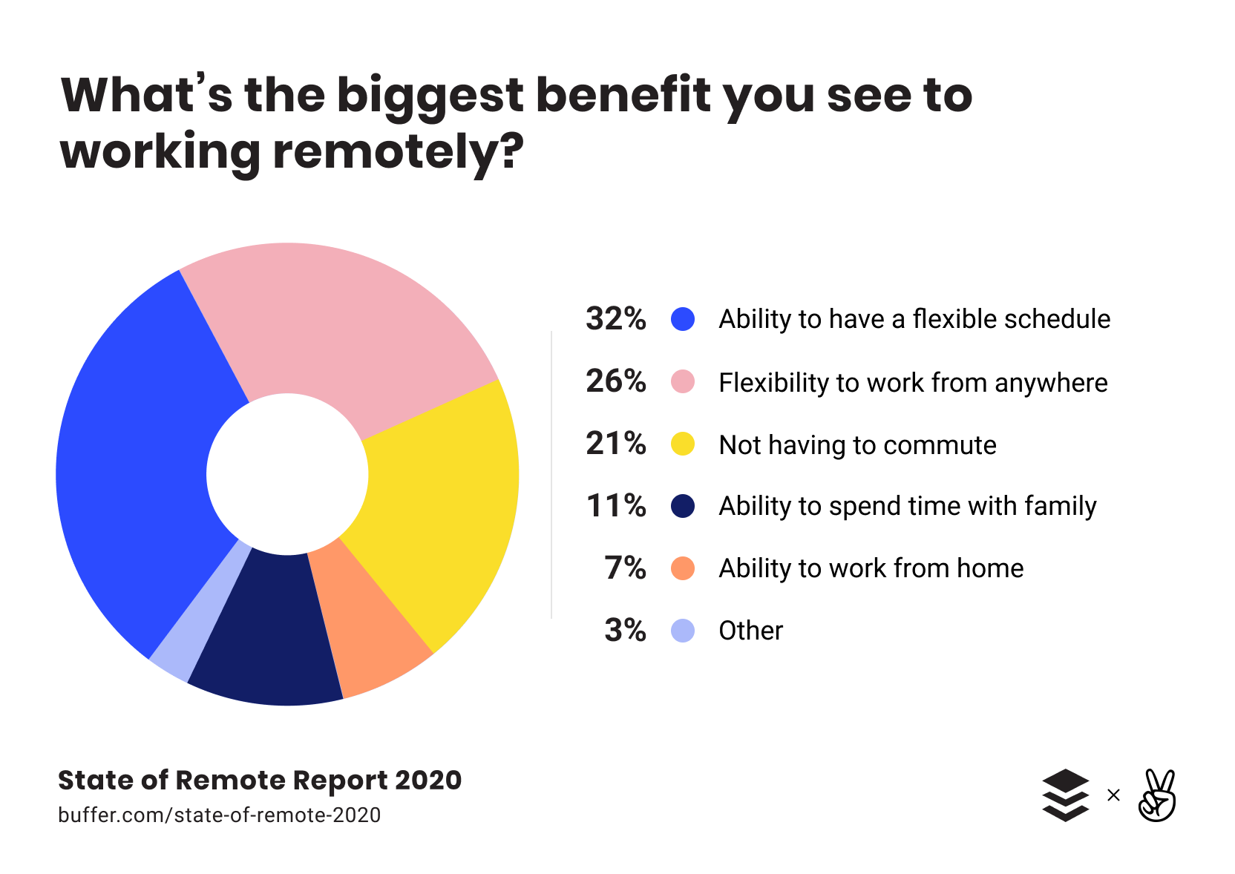
Notes:
Trust requires:
Psychological safety
Dynamic conversation
Listening
Contributing
Collaborating
Being available and being present
Transparency and information sharing
Consistency and dependability
All-way accountability
Fallibility

Slide 18
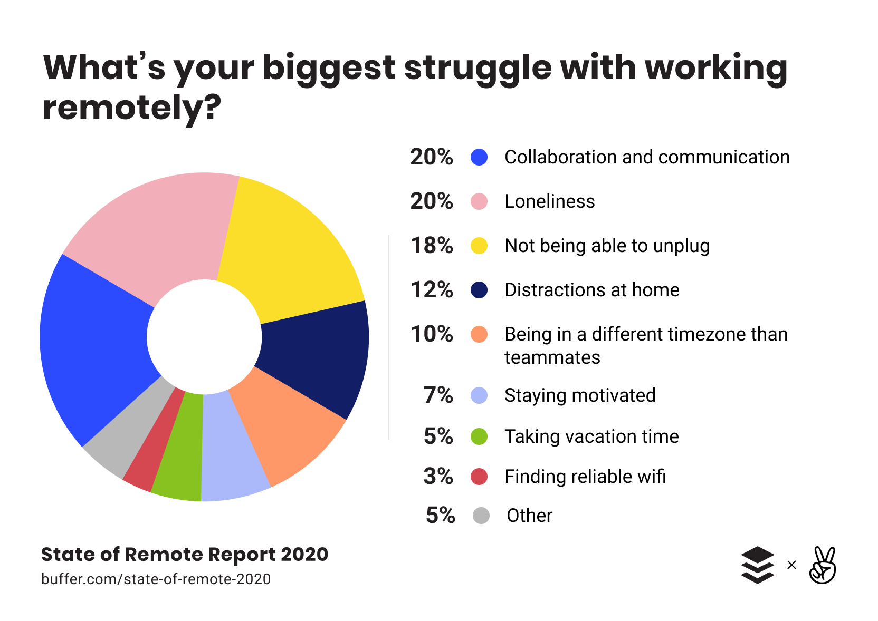
Notes:
Trust requires:
Psychological safety
Dynamic conversation
Listening
Contributing
Collaborating
Being available and being present
Transparency and information sharing
Consistency and dependability
All-way accountability
Fallibility

Slide 19
Non-Traditional Benefits
Dependent Care Benefits
Remote Work
PTO
Flexible Scheduling
Health Plans:
Alternative Health Access
Care Management / Claims Advocacy
Trends in High Deductible Health Plans
Aggressive Cost-Saving Measures

Slide 20
PTO
In a year when trip cancellations abound and travel is fraught, many employees are staying home
Most employers not making permanent PTO program changes now
Many employers are keeping firm on existing PTO policies
Some employers are allowing a larger carryover of PTO than usual this year
Although many employers initially allowed employees concerned about returning to work due to COVID-19 concerns to stay home without using PTO, that tide is turning and more employers are requiring employees to use PTO if they want to stay home and no other paid leave (e.g. FFCRA) is available.
PTO Donation programs are hot right now!
PTO Donated to Other Employees: For best tax treatment, design PTO donation program so that donated PTO can only be used for medical emergencies or certain natural disasters; consult Rev. Rul. 90-29 and IRS Notice 2006-59.
PTO Donated to Charitable Organizations: Employer will need to tax PTO unless it falls within special IRS exception, e.g., IRS Notice 2020-46 provides special tax treatment for PTO donated to charitable organizations for the relief of COVID-19 victims

Slide 21
PTO
PTO trends
Removal of long waiting periods (e.g. 1 year) to start accruing PTO, even in higher-turnover lower-wage positions
Trend is towards more PTO, not less; still significant variation by industry
For employers with lower turnover, more employers are making the full year’s PTO amount available as of January 1, even before it’s accrued
If employee terminates employment having used more PTO than they have accrued, employer works with them to get “repayment” of the unearned PTO; state withholding laws should be consulted before withholding the repayment from final pay
Unlimited PTO
Mandatory PTO

Slide 22
Non-Traditional Benefits
Dependent Care Benefits
Remote Work
PTO
Flexible Scheduling
Health Plans:
Alternative Health Access
Care Management / Claims Advocacy
Trends in High Deductible Health Plans
Aggressive Cost-Saving Measures

Slide 23
Flexible Scheduling
Flexible Scheduling
Allows employees to split their work hours during the day, and/or to work more hours on some days than others (e.g., 10 hours Monday through Thursday with Fridays off)
Flexible scheduling is not “It doesn’t matter how many hours I put in as long as the work gets done”
Pandemic has necessitated flexible schedules for many employees due to child care needs
Advantages of flexible scheduling:
Allows motivated workers to work their full hours around other important obligations
Can be used to limit number of employees in workplace at any given time, thus limiting potential COVID-19 exposures
Disadvantages of flexible scheduling:
Not appropriate for many industries
If not managed carefully, can lead to performance issues
Can raise wage/hour challenges

Slide 24
Non-Traditional Benefits
Dependent Care Benefits
Remote Work
PTO
Flexible Scheduling
Health Plans:
Alternative Health Access
Care Management / Claims Advocacy
Trends in High Deductible Health Plans
Aggressive Cost-Saving Measures

Slide 25
U.S. Observations
Health care cost increases are a key driver of U.S. deficits
There is considerable discussion around whether healthcare is a right
The personal doctor had an 88% favorability rating, higher in the Midwest
Fee for Service providers in real pain due to COVID-19; repercussions will continue for at least 12 months, possibly longer
We must meet our employees where they are:
World is more virtual: virtual visits and remote testing
Telemedicine is here to stay
Telemental health removes barriers to treatment and lessens stigma

Slide 26
New Message
Providers want to control the consumer journey – including direct access to affiliate providers and locations
Patients demand instant satisfaction and a reasonable price
Provider compensation must move to align with quality and outcomes vs. Fee for Service
Will we see a move back to capitated risk pricing?

Slide 27
Alternative Health Access – Virtual Options
Telemedicine: up 43% during COVID-19 – providers have adjusted and included virtual visits. Have they changed the cost? What was the problem they were solving? Patient access, keeping business open?
Telemental health: began as a way to improve patient access to providers. Has expanded to Talkspace (Michael Phelps), CALM, PSYCHhub, Sanvello, etc.
EAPs begin a return to prominence as a core benefit
Mobile apps such as Health Joy and Fitbit take over for patient reminders and education drip campaigns
Wellness programs have expanded to include not only physical fitness, but financial and mental fitness and resiliency programs as well
Emerging mobile technology to measure blood pressure monitoring, blood glucose and improving behavior

Slide 28
Alternative Health Access – Direct Primary Care
On-site/Near-site clinics
Virtual clinics
Neighborhood family clinic
NICE Healthcare
Retail clinic (CVS/Walgreen’s/Walmart)
Employers carving out their own “network” of providers including primary care

Slide 29
Alternative Health Access – Compliance Considerations
“Alternative” does not equal “compliance free”
ERISA/COBRA/HIPAA compliance obligations often apply
If alternative health access program is bundled with a major medical plan, compliance obligations typically easy to meet
If alternative health access is offered “outside” of major medical plan, compliance obligations can mount up
E.g., SPD, 5500, COBRA, HIPAA privacy/security, etc.
HSA eligibility: where costs are waived for patients, HSA eligibility could be threatened
Exception under CARES Act: waiving costs for telehealth and other remote care services from March 27, 2020 through last day of plan year beginning on or before 12/31/2021 will not threaten HSA eligibility

Slide 30
Care Management / Claims Advocacy
Chronic Condition Management and Large Claim Management
Recent poll: 10 most common health issues in the U.S. are physical activity and nutrition, obesity, tobacco, substance abuse, HIV/AIDS, mental health, injury and violence, environmental quality, immunization, and access to health care
Health crises in 2019 included: injury from vaping, opioid abuse, antibiotic resistance, foodborne outbreaks, and measles
Many health plans have condition management for diabetes, asthma/COPD, and cardiovascular conditions.
Very few employees opt in to these programs when they are offered voluntarily
Some employers who use population management expertise to analyze workforce may find unique health issues based on employee demographics and geography

Slide 31
Care Management / Claims Advocacy
Case managers are proficient at working through care needs and coordinating same from a distance (by phone or virtual) and have been for quite some time
New focus for case managers is routing to more efficient and effective care at alternative sites (less in/outpatient costs)
This is and has never been a checklist or charm offensive, but a claims culture that makes care accessible, simple, and builds trust

Slide 32
Claims Advocacy
Whether you have a claim denial, trouble getting a prescription that is not on your formulary, or you just need help going through a plethora of medical bills, a claims advocate may be an answer
While this used to involve simply calling the customer service number of your health insurance plan, it now includes pre-care (vetting of best facilities by cost and quality), concurrent review (how did the surgery go, are you all set to go home, do you have care available at home) and post-care (getting bills paid correctly, getting follow-up care coordinated and scheduled, and managing health over time)
Medicare Advantage plans now include 10 post-surgical meals delivered to the home to make sure patients are receiving high nutrition
Patient education
REMEMBER: THE BIGGEST CHALLENGE IN HEALTH MANAGEMENT IS EMPLOYEE ENGAGEMENT

Slide 33
Large Case Management
Large case management has typically involved care around cancer, transplants, premature babies, and blood diseases
Large case typically defined as one with expected costs in excess of $75,000 for an episode of care
Recently large case management has expanded to include large drug claims for conditions such as Hepatitis C, Rheumatoid Arthritis, and other inflammatory conditions
Highest area of cost growth is kidney or renal failure: dialysis is a high cost and high need growth area that has a need for management of care, site of care, and quality as well as cost
Specialty facilities, such as Cancer Centers of America, are generally out of network and located in retiree locations such as Florida, California and Arizona

Slide 34
High Deductible Health Plan Trends
Initial use of HDHPs was thought to raise consumer awareness of cost and wiser purchasing by patients. What we really got was consumer dissatisfaction due to lack of transparency in the system and lack of real education available. Additionally, providers responded negatively.
Health Savings Account were originally anticipated to assist people with saving for health costs during retirement – however, many did not contribute to these accounts, causing people who needed care to avoid it.
Trends: moving away from HDHP as only option to one of a menu of health plan options available to employees (even with small employers). Employee choice and the personalization off health care is now more important and valuable.
Health care should be easy to access, easy to pay for, and easy to understand
Gamification of plans and access to a 24/7 help desk are demanded now.
Health Savings Accounts remain popular at least politically.

Slide 35
Health Savings Accounts – compliance considerations
Trend towards widening the scope of services reimbursed at first dollar coverage (i.e., pre-deductible)
Temporary exception for telehealth
COVID-19 testing/treatment
2019 expansion to include certain treatments (e.g., statins, blood pressure monitor, ACE inhibitors, and more) for specified conditions including diabetes, asthma, hypertension, heart disease, and certain others
Expansions should be interpreted narrowly – do not assume that any medical expense can be reimbursed at first dollar without impacting HSA eligibility
We are seeing employees & spouses switching between plans more often, and more frequent change among all employers in plan offerings – can impact HSA eligibility
Watch out for an employee whose spouse has FSA or HRA coverage, since that can impact the employee’s HSA eligibility
FSA carryovers also cause an employee not to be HSA eligible
As employees work beyond age 65, Medicare enrollment impacts HSA eligibility

Slide 36
Aggressive Cost-Saving Measures
Self-funded plans can negotiate PBM contract to maximize benefits
Plans can use financial incentives to “steer” patients towards lower cost high quality providers – e.g., direct contracting, narrow networks, physician rating programs, medical tourism
Reference based pricing
Excluding high-cost drugs or treatments
Transitioning individuals with large claims to individual health insurance plans or public option
Excluding spouses and/or children from plan (usually spouses)
Eliminate traditional group health plan and adopt Qualified Small Employer HRA (“QSEHRA”) or Individual Coverage HRA (“ICHRA”)
Notes:
We’re going to pull out a few of these for more examination
RBP
ICHRAs

Slide 37
Reference-Based Pricing
What it is: self-insured health plan only reimburses costs up to a “benchmark” cost that is often referred to as the “allowable amount”
Brings all three actors in the health plan system (providers/payor(employer)/patients) into the mix and discusses efficiencies available in care and cost, along with outcomes
Essentially, plan decides what it will pay without regard to network prices, and with regard to a third party benchmark
Example: Plan will pay 200% of Medicare reimbursement rates for all or certain health care expenses
Practical obstacles we’re seeing:
Providers are under no obligation to limit their charge to the plan’s payment. Provider can go after patient for balance of bill, which employer may end up paying through negotiation and/or settlement
Can be drawn-out and contentious process
Confusing for employees to understand; typically creates more paperwork for them
Compliance considerations
ACA maximum out-of-pocket requirements: balance billing amounts will count towards the ACA’s maximum out-of-pocket limit (causing those limits to be more quickly met) unless plan follows federal guidance to show it has adequate access to providers who will accept the plan’s payment as payment in full

Slide 38
Reference-Based Pricing
What is the problem it is attempting to solve? Is there a better way?
Who should consider reference-based pricing?

Slide 39
ICHRA – What It Is
In lieu of offering a traditional group health plan, employer offers employees a capped dollar amount to purchase coverage in the individual insurance market and from Medicare
Big Picture
Can’t give employees a choice between a traditional group health plan and ICHRA
Must offer same dollar amount to every employee in same “class” subject to some variations for family size and age, but not for service, merit, wellness plan participation, etc.
If you offer an ICHRA to employees in a class, must offer it to all employees in the same class (and you can’t define your own classes, you must use IRS definition

Slide 40
ICHRAs
How does an ICHRA work in the practical sense?
Who should consider an ICHRA?

Slide 41
Aggressive Cost Saving Measures: compliance considerations
HSA Eligibility – where costs are waived, HSA eligibility could be threatened
ERISA – may require changes to plan documents
ACA – Strict rules for reference-based pricing to pass the ACA’s maximum out-of-pocket rules
HIPAA Nondiscrimination – limitations and exclusions directed at individual participants based on a health factor typically violate HIPAA nondiscrimination rules
ADA – limitations and exclusions targeting particular individuals with disabilities could violate the ADA
HIPAA Privacy/Security – if plan claim data used to encourage employees to disenroll in health plan, that could violate HIPAA privacy rules
Medicare Secondary Payer – these rules typically prohibit employers from incenting employees to drop employer coverage in favor of Medicare
State Insurance Laws – employers with fully-insured plans may have limited options for reducing plan costs due to state insurance laws
QSEHRA/ICHRA option – heavily regulated

Slide 42
How To Choose

Slide 43
Maximize Effectiveness Of New Benefits: A Decision-making Tool
Ask and answer the 4 Questions
Limit product variety initially
Educate and Incentivize
Take credit
How does the benefit fit into the employee’s overall total rewards package, and is it consistent with desired compensation strategy (i.e., at market or above market)?
Will employees value the benefit?
How can external partners support the company’s benefit administration and compliance? Who will be responsible for what?
Is there budget to implement? If not, can program be revised to fit into budget?

Slide 44
Questions?

Slide 45
Pharmacy landscape and market update
February 16, 2021
Jay N. Scott, CHC
SVP, Employee Benefits Practice Group Leader
© 2020 USI Insurance Services. All rights reserved..

Slide 46
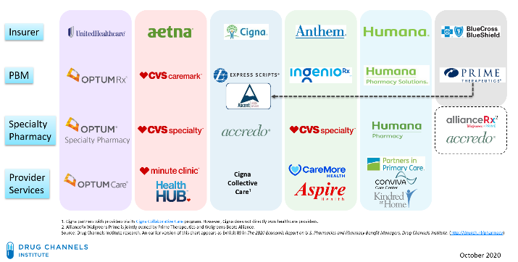
Overview
Prescription drug costs are growing at three times the rate of inflation and represent an area of increasing concern most employer sponsored benefit plans.
Pharmacy costs are unique in that the carrier/Pharmacy Benefit Manager (PBM) typically earns profit in the cost of the claim as opposed to the cost of insurance or administration.
Employers have little to no visibility into the carrier or PBM profit embedded in their plan.
Cost savings opportunities exist in both drug pricing and drug utilization.
An unmanaged plan can represent a savings opportunity 15% to 25% of pharmacy costs or $200,000 for a group of 500 employees.
Vertical Integration of PBMs & Carriers¹
Annual U.S. Prescription Drug Spending
2018 Specialty Spending:
$
170.2
BILLION
²⁰¹⁹
Specialty Rx Treatment:
Average cost
$507.9 billion ²
$52,486
Median wage
$48,665
Sources: 1. Drug Channels Institute https://www.drugchannels.net/2019/12/insurers-pbms-specialty-pharmacies.html;
2. Oxford Academic/American Journal of Health System Pharmacy (AJHP) 8/1/2000

Slide 47
The Flow of Money - Complicated & Confusing

Slide 48
Why is Pharmacy Important?
GROWING EXPENSE Growing at three times the rate of inflation
SOARING PRICES A recent study by IMS Institute for Healthcare Informatics found that pharmaceutical spending was $425B in 2015, and is expected to grow to $610-640B in 2020.
VISIBILITY High visibility with outrageous specialty medication pricing
SPECIALTY DRUGS Used primarily to treat chronic or life-threatening diseases, specialty drugs represent 1-2% of all prescriptions but drive 37%-50+% of drug spend and is expected to continue to grow exponentially
DRUG PIPELINE Over 7,000 drugs are currently in some stage of development; 60%-70% estimated to be specialty, and up to 50% of those might be considered Limited Distribution Drugs (LDD)
SPEND On average, our clients’ pharmacy spend is 25% of the entire plan. Some employers can be as high as 50% of total spend

Slide 49
Why is Pharmacy Important?
AGING POPULATION Due to medical advancements, people are living longer, working longer and being diagnosed sooner for chronic conditions
LACK UNDERSTANDING The brokerage and consulting industry has ignored the pharmacy plan for too long, which creates an opportunity for USI
COST SAVINGS Vendor pricing concessions on specific and admin premiums are buried in the Rx claims when possible
CARRIER PROFITS Carve-in Rx contracts represent a huge revenue stream for Health Plans/TPAs
ACCURACY Most fully insured renewal projections are wrong because loss ratios don’t factor in rebates and spread pricing as retained revenue
TRANSPARENCY Contracts are often vague with weak definitions, undisclosed revenue streams, undefined terms and limited audit rights

Slide 50
COVID-19 Related Drug Utilization Trends
Chronic condition Rxs increased, Acute condition Rxs decreased
Temporary Shift in 30-day to 90 Day prescription fills
Comprehensive approach in managing employee health
Drug makers hike prices due to COVID-19 pandemic1
Pfizer, Sanofi, GSK plan to rise prices on more than 300 drugs
Other vaccine prices increase1
Shingirx 7%, DTp 8.6% (GSK)
Overall healthcare dollars lowered due to reduction in elective surgeries
1. https://mobile-reuters-com.cdn.ampproject.org/c/s/mobile.reuters.com/article/amp/idUSKBN2951Q2
Notes:
Drug utilization trends centered around a few main shifts over the last several months.
Drug Utilization trends since March
-Peaked in March (refill early)
-Drop-off in April, May (No mail order in April) → drop in office visits, elective procedures, hospital/medical spend
-Leveled off to normal after dip in May
Membership Numbers Fluctuating - Millions of Americans, newly out of work, are also newly uninsured. Millions more who still have insurance have been forced to delay necessary but noncritical treatments.
Increase in chronic condition prescriptions – We have seen some decrease in prescriptions for acute medications that you might normally get for the common cold or aches and pains, and we are seeing a disproportionate amount of chronic medications – more than we have seen in the past. That is likely to be a short-term phenomenon caused by the pandemic. As the world moves into the next several months and beyond, we’ll probably expect the number of prescriptions for acute conditions tick back up.
Shift from 30-day to 90-day prescription fills – We’ve also seen people shift from taking 30-day fills of their prescription drugs to getting 90-day fills. This trend will probably continue as we move forward because once people make that shift, they are more likely to stay with it. Most of the pharmacy benefits managers (PBMs) have relaxed their refill-too-soon policies temporarily, as they make sure people have access to their medications. It’s appropriate, as things begin to resolve, to expect a shift back to 70%-80% refill rates so that people cannot stockpile medications. For example, with a 70% refill rate for a 90-day prescription, people will need to wait until day 63 to refill their medication, which is appropriate.
Looking Forward – Since COVID, doctors across the country have been granted broad flexibility to treat patients remotely, using telemedicine, instantly reshaping services. Covid-19 has pushed the inevitable telemedicine revolution forward by a decade, if not more, according to health care leaders. As part of a comprehensive approach to managing employee health, your clients will be looking for new workplace procedures and programs that help them ensure the safety and wellbeing of their employees, especially those returning to work for the first time. It will be important that they consider changing (or implementing) plan design incentives that encourage their employees to participate in regular health screenings and get vaccines.

Slide 51
How Do Pharmacy Benefit Managers (PBMs) Work?
A Pharmacy Benefit Manager (PBM) is a company that administers, or handles, the prescription drug benefit component of an employer's health plan.
Almost all plans have PBM’s, some are bundled and often owned by the carrier and some are an unbundled 3rd party PBM’s.
A PBM processes and pays for prescription drug claims and is responsible for assisting the employer with managing the prescription benefit, including developing the formulary.
https://www.prxn.com/docs/PRxN%20Understanding%20PBMs.pdf

Slide 52
How Do PBMs Make Their Money?
Administration fees: Fees for processing claims
Spread pricing (Example to follow): Differential amount between what the PBM pays the pharmacy and bills the plan—the PBM retains it as profit. Spread amounts vary and are not revealed to the plan but PBMs are generating huge profits from this practice
Rebates (Example to follow): Drug manufacturers pay PBMs rebates to promote expensive brand-name drugs that do not have a generic equivalent—they are supposed to be passed on to plan sponsor but often they are pocketed by PBMs
“Bona fide” service fees: Fees PBM’s get from pharmaceutical companies for data, studies, distribution promotion, etc.
“The market for prescription drugs is convoluted and opaque.”
- CMS Administrator Seema Verma
Source: https://www.cms.gov/newsroom/press-releases/cms-issues-new-guidance-addressing-spread-pricing-medicaid-ensures-pharmacy-benefit-managers-are-not

Slide 53
Issue: Spread Pricing
Most buyers are unfamiliar with what the term Spread Pricing means
PBM bills the Employer (Plan Sponsor) at a higher price
Ex: $130
Employee fills a prescription at a pharmacy, using Employer provided Rx coverage
PBM
+$30
Pharmacy bills Pharmacy Benefit Manager (Rx Carrier) negotiated rate
Ex: $100

Slide 54
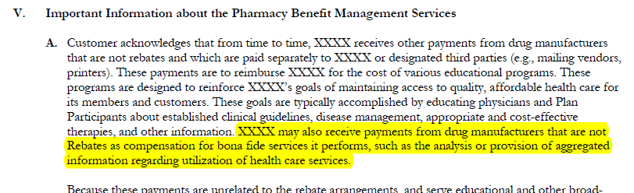
Rebates
Rebates paid from the drug manufacturer to the PBM, now account for as much as 33% of total pharmacy expense.
Typical Contract Language that Drives PBM Profit by Retaining Rebates and other Fees
Carrier/PBM states that they are contracting with manufacturers for their “own account” or benefit AND that the customer acknowledges that Carrier/PBM will retain all or some portion of the rebates received.
Employer acknowledges that Carrier/PBM receives other payments from drug manufacturers that are not rebates but are additional sources of profit.
Typical rebates and fees can easily exceed $500 PEPY
Desired State: Contract Language that Drives Employer Savings
Administrative Services and Fees.
Administrative Fee
$2.75 per paid claim
Rebate Sharing
100% to CLIENT
This contract has 100% sharing of rebates back to employer in addition to minimum guarantees.
Guarantees must be negotiated to offset projected carrier rebate revenue.
The minimum rebate guarantees are:
2019 3-tier rebates per qualified brand claim
Retail 1-30 $146.00
Retail 31-90 $329.00
Mail $358.00
Specialty $899.00

Slide 55
Drug Definitions
AWP discount guarantees can be manipulated by changing the definition of generic and brand drugs thereby reducing the discount provided.
Typical Contract Language that Drives PBM Profit
Typical discounts are 80% off AWP of generic drugs and 20% AWP of brand drugs.
When PBMs manipulate definitions of “brand” drugs to include some “generic” drugs, smaller discounts are provided.
This language is a much clearer definition of brand vs. generic drugs as defined by Medi-span (a nationally recognized independent database).
This prevents manipulation of drug categorization in order to artificially inflate performance and meet pricing guarantees.
Desired State: “Best in Class” Contract Language that Drives Employer Savings
Brand Drug - Single or multisource brand drugs which are classified as a brand drugs, based upon indicators provided by Medi-Span’s National Drug Data File and denoted in the Multi-source Code field as “M”, “N”, and “O”.
Generic Drug - A multisource prescription drug, which are classified as generic drugs, whether identified by its chemical, proprietary, or nonproprietary name provided by Medi-Span’s National Drug Data File and denoted in the Multi-source Code field as “Y”.

Slide 56
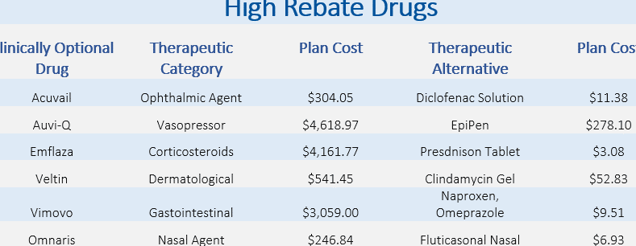
Formularies
PBM formularies may be designed to drive profit instead of focusing on clinical effectiveness.
Carrier/PBM disclose that they may choose drugs for the formulary that are more expensive than non-formulary drugs and that this decision could be driven by rebates paid to Carrier/PBM.
Examples of high rebate drugs that may be on a formulary, despite low-cost, therapeutic alternatives.
USI reviews formulary options to reduce inclusion of drugs for the purpose of inflating PBM profit.

Slide 57
Questions

