Slide 1
Culture Eats Vision: Talent Attraction & Retention 5-Step Road Map for a MindShift
WELCOME
Featuring: Todd Kuckkahn
Notes:
Thanks for trusting me to present to you today.
One valuable idea to grow your corporate culture.
Share snippets of my experiences throughout this presentation.
No “one-size fits all” for corporate culture.

Slide 4
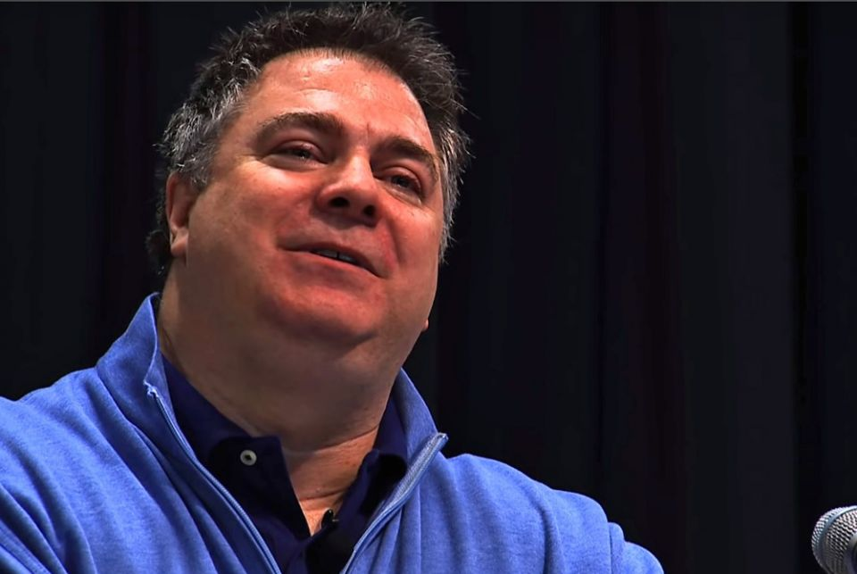
Are you broken?
kintsugi

Slide 7
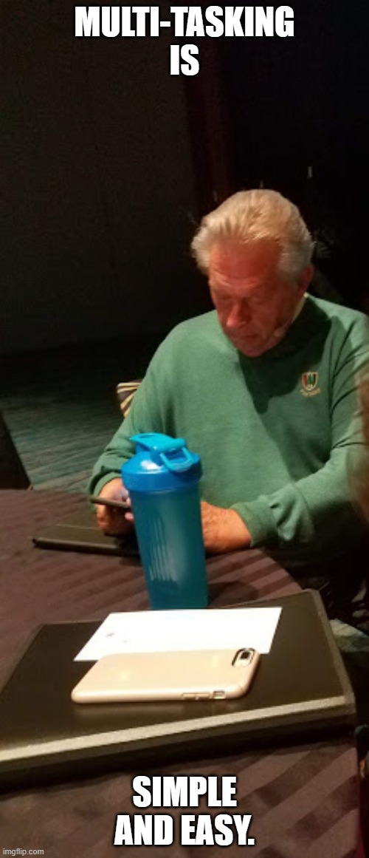
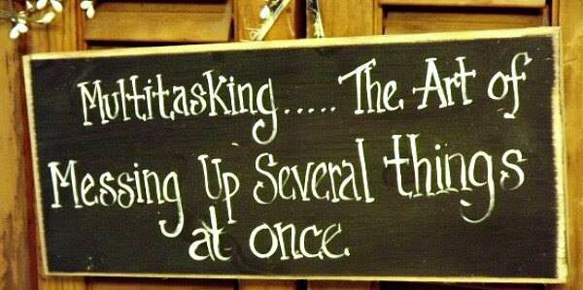
Studies have found that multitasking reduces your productivity by 40%!
Notes:
1. Multitasking is damaging your brain—Constant interruption (which is what multitasking is) brings on higher levels of stress.
2. Multitasking makes you less productive—According to Dr. Susan Weinschenk, multitasking isn't even the right word. What really happens is task-switching, and it takes more time to switch tasks than stick with them until you finish. Studies have found that multitasking reduces your productivity by 40%. 40%!
3. Multitasking makes you dumb—It lowered IQ scores as much as if study participants had used marijuana or stayed up all night.
4. Multitasking makes you prone to cheat—According to Weinschenk, you "make more errors when you switch than if you do one task at a time. If the tasks are complex then these time and error penalties increase."
5. Multitasking hides tools that are working against you—Multitasking makes us feel very busy, and it often leaves us feeling like we've been productive and good workers, though strangely panicked at the sight of our to-do list with its scant completion rate.
6. Multitasking lowers the quality of your work—A study by the National Bureau of Economic Research revealed that multitasking reduces worker performance, makes projects last longer, and creates that panic-inducing backlog because your to-do list isn't getting done.
7. Multitasking reduces the ability to make connections—Study after study has shown that when you multitask, you lose the ability to remember what you were doing, you are unable to learn as much, and you have difficulty putting what you're learning into new contexts.

Slide 8
Return On Investment

Slide 9
Speak your peace

Slide 10
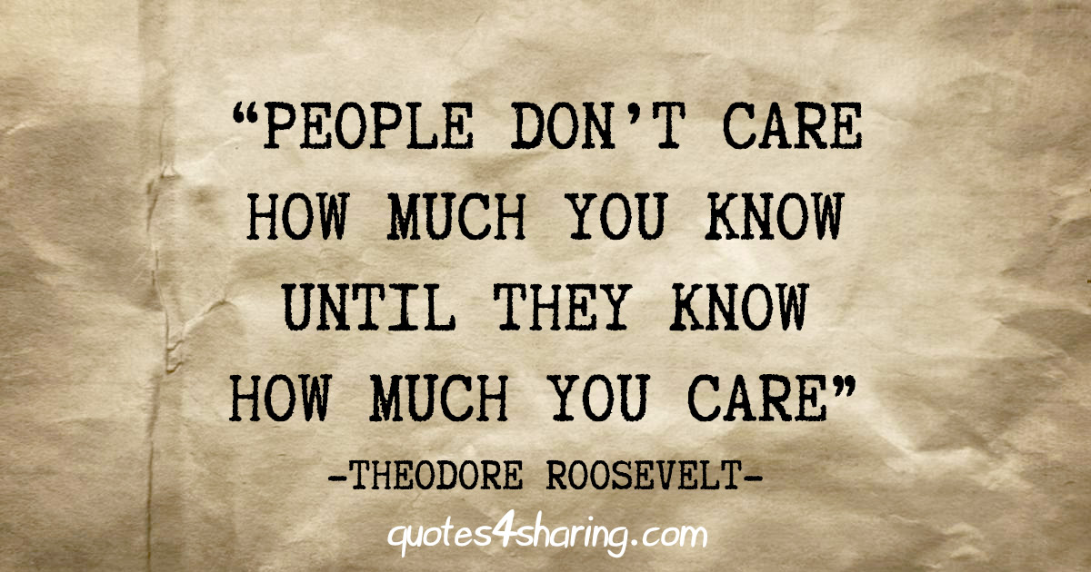

Slide 11
Todd’s Talent engagement Cycle
Self-Engagement
Pre-Engagement
On-Engagement
In-Engagement
Re-Engagement
Notes:
SELF: Inside Out—Basically, what are individuals doing to grow?
PRE: The time period before someone is hired, beginning from when they may visit or find you online or see you on social media or learn more from an employee.
ON: The time from when they are hired to the point they might be considered an engaged employee, maybe what was at one time known as the probationary period
IN: Current engaged employees
RE: Employees who have left the organization, unless due to something illegal or immoral.

Slide 12
Self-Engagement (leadership & Change)
What are you doing for yourself?
Spending time to think?
Intentional reading?
How are you growing?
How are you developing your next leaders?
Notes:
Do any of you spend time just thinking? With a blank sheet of paper and a pen? In a quiet space?
Did you consider your learning over when you got that degree or certificate?
And isn’t it good to know that there are a lot of simple things that require NO talent.

Slide 13
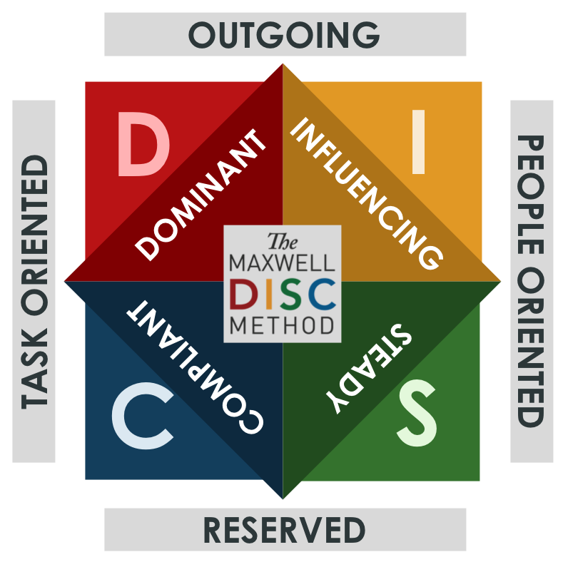
Self-ENGAGEMENT solution
5-Step road map for a mindshift
Core values
Wheel of life
Differences make us better
tlc
Comfort zone

Slide 14
Pre-Engagement (before they’re hired)
What are you doing to recruit talent before you even know them (i.e. messaging)?
How are you rejecting candidates to enhance your community?
What are you doing to create and promote the right corporate culture?
Notes:
Are you going to where the employees are? If you need IT staff are you going to Indeed or where gamers go? Going to gaming sites to recruit IT talent.
How are you rejecting candidates?—Are you communicating along the way in case they become the next employee you might need? Are you collaborating with other businesses to assist them in talent attraction (Boys & Girls Club—Kevin)

Slide 15
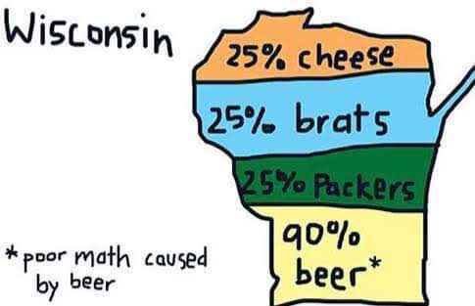
Pre-Engagement solutions
www.everythingpointshere.com
Lineage Logistics-Stevens Point
Communication>Trust>Conflict
Employee Referrals
This might not get people here.
Notes:
Picture of my wife and me at spring break
www.everythingpointshere.com (jobs, fun, housing, education, quality of life, bragging rights, KiMobility NOT using site
Lineage Logistics-Stevens Point—visitor gift strategy, tours
www.inspirewisconsin.org tours, apprenticeships, job shadow, internships, one-on-one email conversations, marketing tool for businesses
Social Media & Digital Marketing—geofencing, track effectiveness, A/B Testing, retargeting, mobile friendly, email marketing₁₃ BERGSTROM EXAMPLE
Benefits: State and federal law compliance, Health, dental, life, STD, LTD, retirement, PTO/vacation/sick—How about Unlimited PTO?
Job description and interview questions relate to position and functions
Telecommuting, flex-time, “workday”-watching children’s sports and arts activities, chickens water is frozen, “work at home” brings its own challenges for culture however
40 for 30-Google, VTO, work on entrepreneurship
NEWaukee YP Week Bubbler Awards (three years of winners)
Engaging With Education (K-12, Tech, 2 yr., 4 yr.)-Reality Shops, Heavy Metal Tour (good for any industry), Career Fairs, Post-Secondary Night (incl post-secondary & business), classroom presentations

Slide 16
On-Engagement (“probationary”)
What are you doing with new employees right after they are hired AND when they first arrive?
How are you immediately engaging employees?
How are you forging connections with employees?
How are you encouraging connected communication?
Notes:
By the way, when you tell employees they are NOT hired, what do you do? Send a rejection letter/email or do you recruit them for others in the community. Send them to something like the EPH website?
What does on-engagement do?₁
Attract and retain top talent
Engage employees immediately
Build trust and alignment
Forge connections with employees
Encourage connected communication
What are you doing with new employees right after they are hired AND before they first arrive
Great opportunity to have newest employees evaluate the pre-engagement process.

Slide 17
On-Engagement solutions
Make “it” meaningful
Leadership Opportunities
Educate the team about the person
Paperwork & technology
Mentoring program
Share informal rules
“Check-ins” (MBWA)
Dress code=”Dress Appropriately”
Swag/Bling
Community Engagement (e.g. Ignite)
Pay To Leave (e.g. Trainual)
Notes:
Educate the team about the person—NOT the employee, go beyond degree and address—get a short bio early to staff, picture on website
Does paperwork drive first impression?—we get interns and new staff directly engaged in work, not filling out all of the forms, 3 days of HR “Hell”—sorry HR folks
Assign a mentor—could be internal or external, someone from Chamber or business community, probably from a different dept if internal
Learn informal rules—going out for lunch?!?!, leaving early, parking spots
Regular “check-ins”—NOT evaluations—YOU LISTEN, encourage the employee to ASK questions
Dress code-”Dress Appropriately”—use memes or other photos to suggest the appropriate
Set up “logistics” (work area, calendar, email, technology access, parking, key)
Swag/Bling—get them in your gear to promote the company to the next employee
Employee Handbook-cultural or legal, even could have them review it for suggestions so they better learn, might pick off some good ideas from their previous firm, WHAT DOES IT SAY ABOUT YOUR CULTURE?
Community Involvement-Ignite Young Professionals, Leadership Portage County
Pay To Leave: Zappos pays $2K to leave during orientation process—they want to be sure

Slide 18
In-Engagement (ongoing retention)
Are your current employees in the right positions? (right seat on the bus)
Are they mentoring your new employees?
Is quality of life as important as paycheck? (or is it the other way?)
Are you encouraging “Safe-To-Try” strategies
Why should someone stay?
Notes:
What are you doing with your current and long-term employees?
Are your current employees in the right positions? (right seat on the bus)—Don’t get rid of a quality employee just because they can’t do the job they are in. Ask the question of why is that and where could they be to help the organization.
Why should someone stay?—KEY QUESTION
Are they mentoring your new employees?
Quality of life can be as important as paycheck (or is it the other way?)--
“Safe-To-Try” strategies₄—inaction more harmful than perfection, decisions never definite (analysis/paralysis), course correct on real-life feedback, use small dose decisions FAIL FORWARD

Slide 19
In-Engagement solutions
Create a company culture team
Flexible scheduling
Performance management
Campaigns fade, accessories, office floor plans
“Surveying” Employees/Follow Through
Notes:
Create a company culture committee-cross representation, clear purpose, leadership buy-in, commitment, fresh & current₈
Flexible scheduling for easier commutes and traveling in sunshine
Performance management—point system? One annual review PCBC—every other week, regular quarterly budget reviews, Keep/Start/Stop, Why do you still love to work here? Where do you want to be in 5 years? How can we help you get there. Do you want to do a 360-degree evaluation—WHY? Is it a process or event? How will feedback be used? (FEET ON THE DESK)—Plus timing of doing it with other culture shift in org.
Campaigns fade (weight loss/health)—sustained loyalty, engage employees in a purpose₁₀
Accessories--Catered meals, stocked kitchens, nap space_{10,} , TVs in common areas₉
Office floor plans-increase space available, interruption (86 minutes a day) vs. interaction_{14,} 70% of all offices now have an open floor plan—the question is why?_{14,} provide a mix of spaces to accommodate everyone’s needs—UWDC moving from offices to “work stations”

Slide 20
Re-Engagement (bring ‘em back)
What are you doing when employees leave your organization?
How competitive are your wages?
Are you looking at the whole person—9 spokes of the wheel of life? (stay tuned)
Notes:
What are you doing when employees leave your organization?
How competitive are your wages?
Are you looking at the whole person—emotional, spiritual, intellectual, social, physical, occupational? Back to the Nine Spoked Wheel

Slide 21
Re-Engagement solutions
Alumni strategy
Regular communication from a variety of “channels”
Are those leaving brand ambassadors?
Job transitioning services
Notes:
Treat former employees as alumni from your college or university-Todd’s expertise
Regular communication from a variety of “channels”-fun & energy
Are they brand ambassadors?
Job transitioning services—exit “conversation”

Slide 22
Todd’s Talent engagement Cycle
Self-Engagement
Pre-Engagement
On-Engagement
In-Engagement
Re-Engagement
Notes:
SELF: Inside Out—Basically, what are individuals doing to grow?
PRE: The time period before someone is hired, beginning from when they may visit or find you online or see you on social media or learn more from an employee.
ON: The time from when they are hired to the point they might be considered an engaged employee, maybe what was at one time known as the probationary period
IN: Current engaged employees
RE: Employees who have left the organization, unless due to something illegal or immoral.

Slide 23
Do you like conflict?

Slide 24
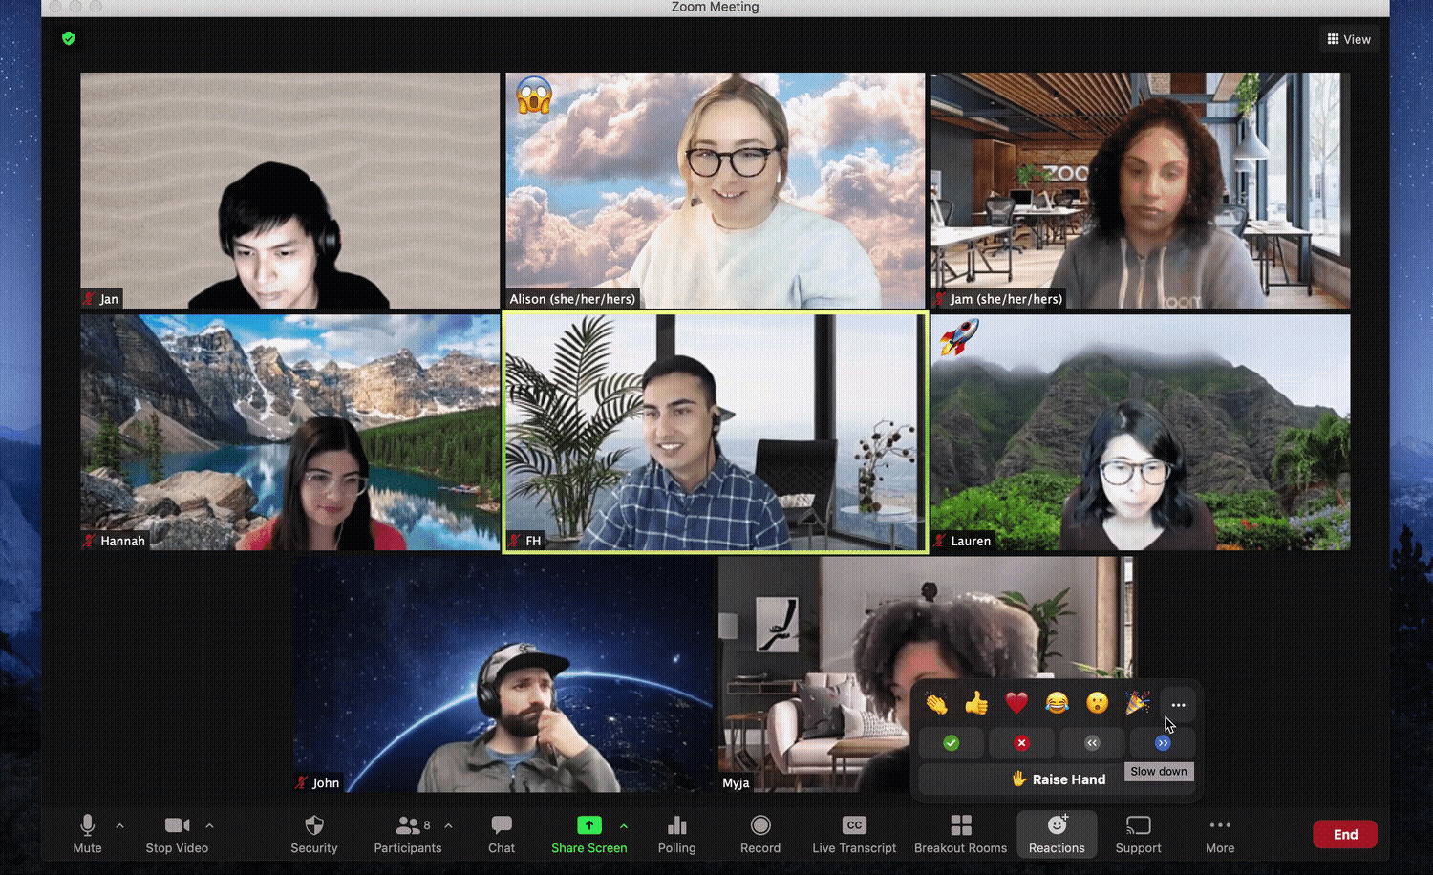
Silos, drama, & barriers

Slide 25
Define YOUR Corporate Culture
Notes:
Can you do it in 25 words or less?
Jot down some ideas.
Not to be judgmental, but if you don’t have a positive corporate culture that is easily defined, that may be the start of the problem.
While it is fairly simple to define corporate and culture, putting the two together is often challenging, yet every organization has one.

Slide 26
DEFINE YOUR CORPORATE CULTURE
Did you embellish?
Were you honest?
Would you post that online as truthful?
Did it take a bit to get started?
Was it hard to keep it under 25 words (less is more)?
How would your co-workers define your culture?
How do you know that?

Slide 29
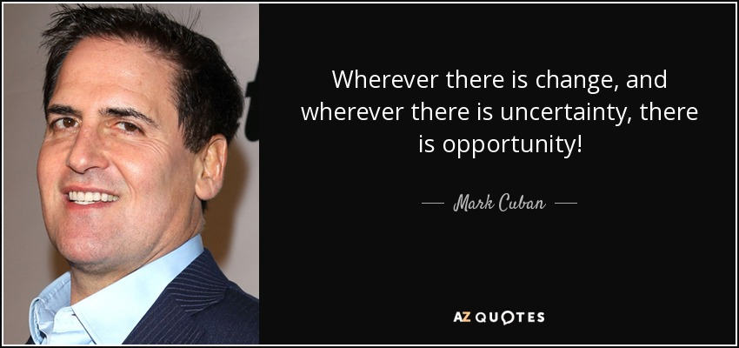

Slide 30
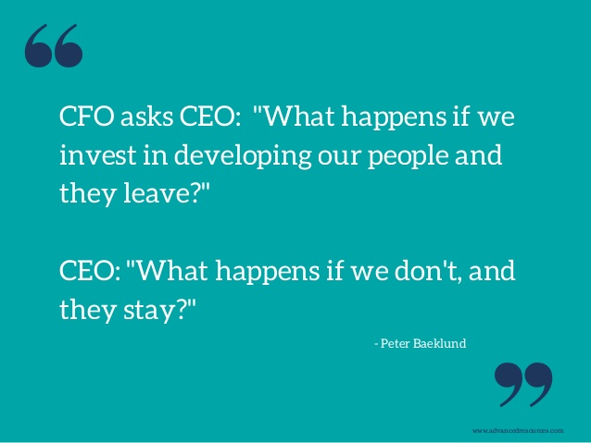

Slide 32
In a Conference for Women survey of attendees, nearly 80% of the respondents would rather have a boss who cared about them finding meaning and success in work than receive a 20% pay increase.
Only 1 in 20 respondents rated their current jobs as providing meaningful work.
Estimated that highly meaningful work will generate an additional $9,078 per worker, per year.
Employees who find work highly meaningful are 69% less likely to plan on quitting within the next 6 months and have job tenures that are 7.4 months longer on average.
Organizations need to proactively support the pursuit of personal growth and development.
https://hbr.org/2018/11/9-out-of-10-people-are-willing-to-earn-less-money-to-do-more-meaningful-work

Slide 33
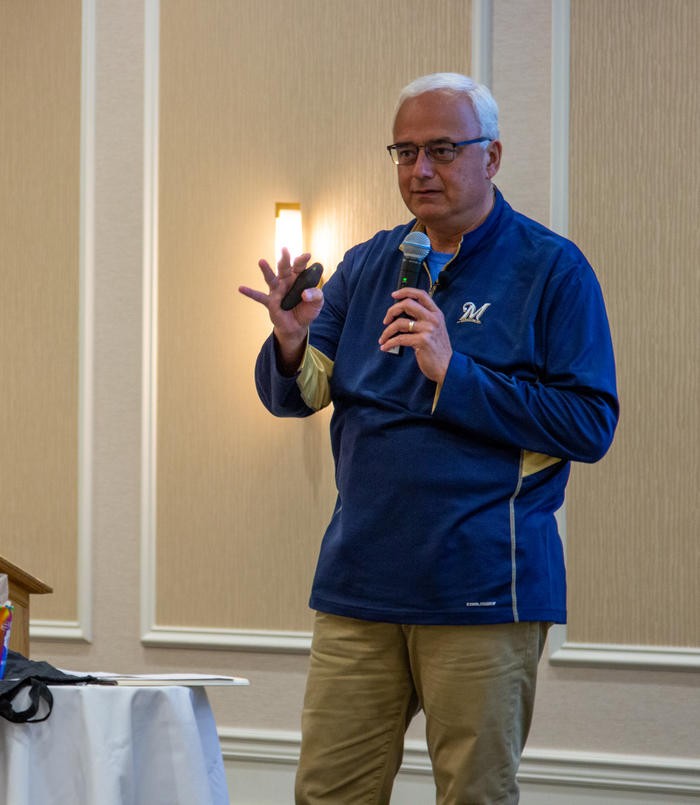
We’re on a mission to revolutionize corporate culture and leadership.

Slide 34
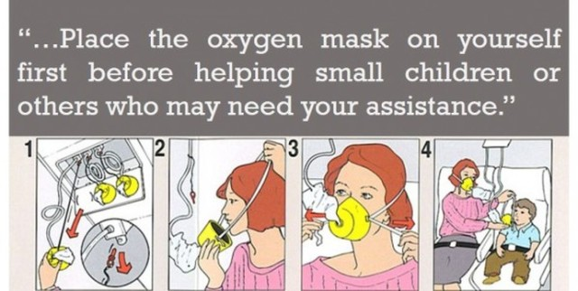

Slide 35
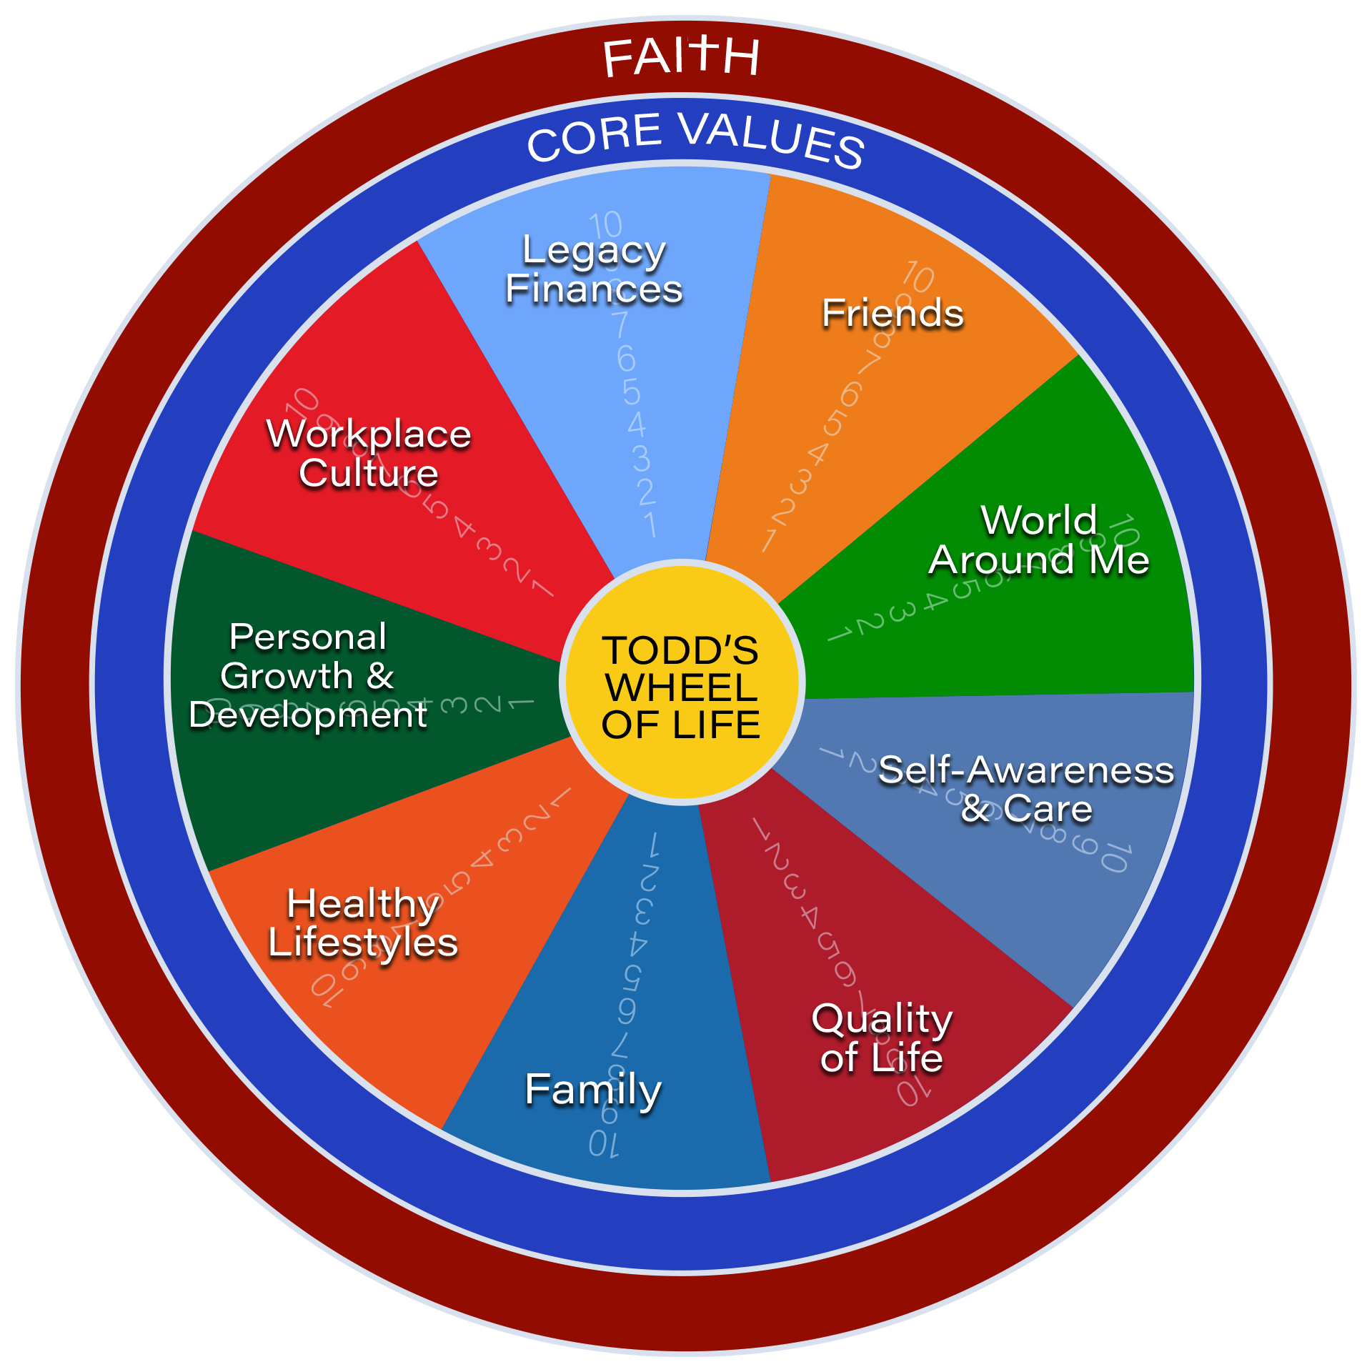
5-step road map for a mindshift
Notes:
There are four key elements to this line crossing journey. They are core values, Life of Pi(e), inner circle and your comfort zone. You should know that any of these four themes can be their own presentation. They are that important. If you are interested to learn more, let me know after the presentation.

Slide 36
Notes:
This quote may be the best way to think about core values.
“Your core values are the deeply held beliefs that authentically describe your soul.”

Slide 37
PEAKS & valleys
What energizes you and brings you joy and fulfillment?
What was a moment of difficulty when you might have failed?
When are you most motivated and inspired?
When do you feel disempowered?
What will your legacy look like when you look back on your life?

Slide 39
Notes:
Core values are different for everyone, whether you are an eagle or a duck. This list is part of a program to help you determine your core values. I know you may not be able to read them. The important thing is that when you identify them they are unique to you and only you. They make you different and not better. Core values are your inner most beliefs that shape you. They impact how you handle fear.

Slide 40
ptimism
rust
onesty
nthusiasm
eamwork
Notes:
These are my five core values and my vain attempt at a cute acronym. I live by these values. Maybe you can see some of them in me. I see many of them in my parents. I don’t think about my values every minute of every day but I know they are there to support me, particularly when leaving my comfort zone, flying over fear and moving through learning into growth. These values are there when I have those tough decisions to make in life.

Slide 41
5-step road map for a mindshift
Notes:
There are four key elements to this line crossing journey. They are core values, Life of Pi(e), inner circle and your comfort zone. You should know that any of these four themes can be their own presentation. They are that important. If you are interested to learn more, let me know after the presentation.

Slide 42
Notes:
The harmony wheel is a balance among nine different key components of your life. I strongly believe it is much more than a life – work balance that we hear so much about. If only it were as simple as the duck and eagle using their wings to balance.
At the center of the wheel are your core values. The nine pieces of the wheel are …………… If we had the time I would have you rate yourself on each of these nine elements of your life. A ten is closest to your core values and one is in on the outside. To score a ten, that piece of the wheel would be the most strongly impacted by your core values and be a strength in your life. Following your scoring it, we would then look at your areas for growth and, maybe, focus on that one for a month, and then the next one and then the next one. It’s more than a wheel, but an exercise in self-improvement and self-awareness to get you out of your comfort zone using your core values.
Right now I’m focusing on family relationships, particularly with my wife. We’ve been together for over 30 years and I’m relearning how important she is in my life and future.

Slide 43
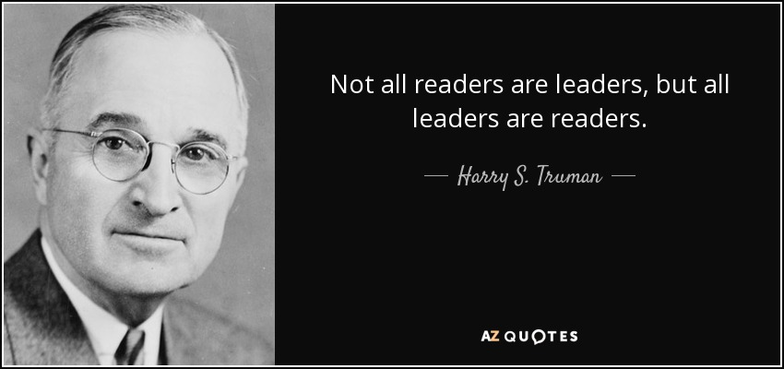
Personal growth & development

Slide 45
5-step road map for a mindshift
Notes:
There are four key elements to this line crossing journey. They are core values, Life of Pi(e), inner circle and your comfort zone. You should know that any of these four themes can be their own presentation. They are that important. If you are interested to learn more, let me know after the presentation.

Slide 46
Notes:
Our weaknesses from the harmony wheel provide challenges for us that our inner circle can often help grow. This is where differences make us better. Just like the eagle and duck are different, their differences could also be each other’s strengths. As you seek out your inner circle, find those who ARE different than you and can help you solidify or modify your way of thinking. Get out of your comfort zone.

Slide 48
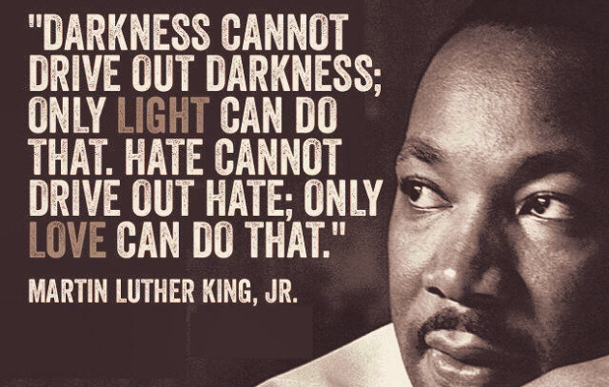

Slide 49
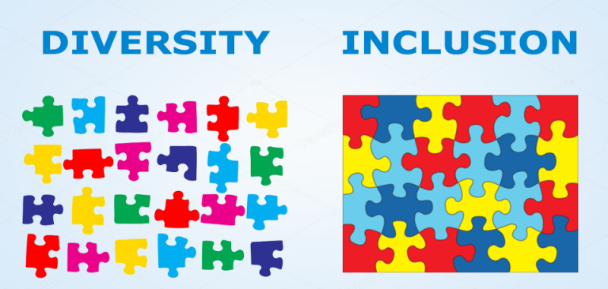

Slide 51
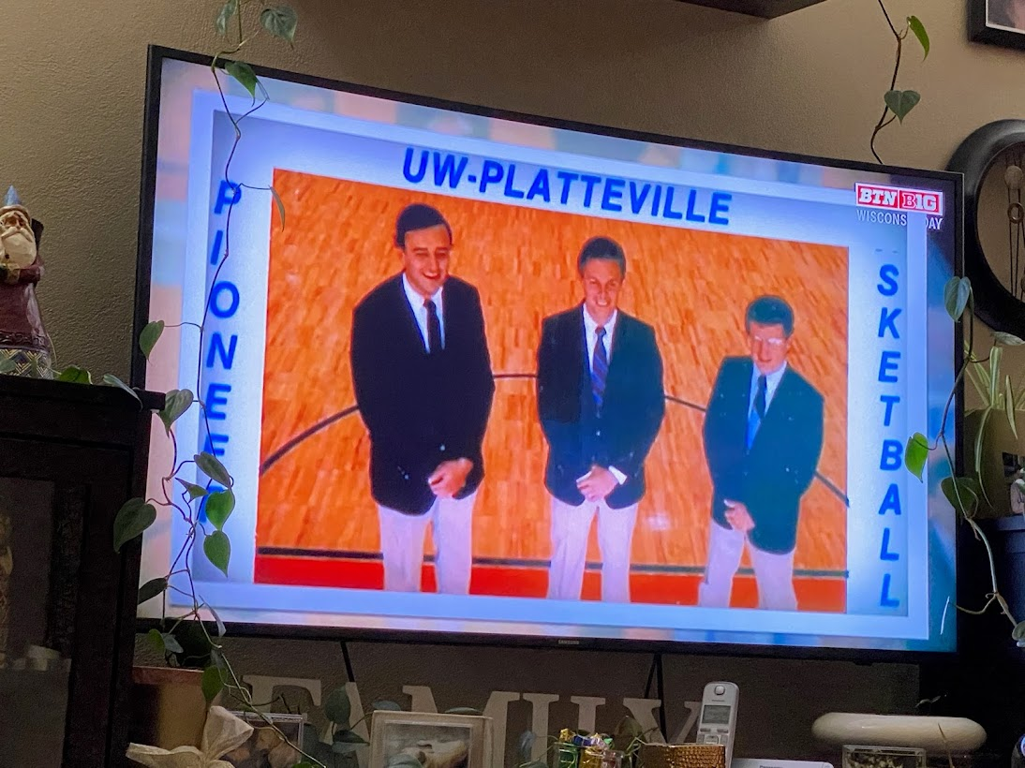
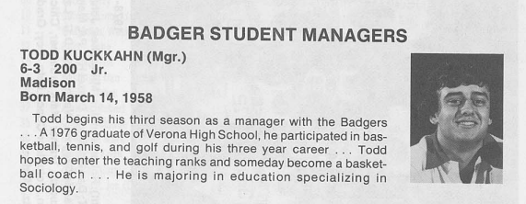

Slide 52
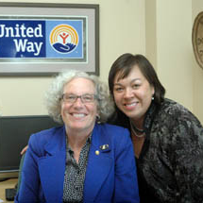
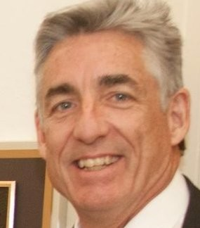
Notes:
I had a great lesson on differences from someone in my inner circle that had a profound impact on my respect for diversity, equity and inclusion. I earned a promotion to vice president at United Way of Dane County. My first task was to hire my replacement. We had a lot of great candidates and when I got it to the final three, I met with the president, in blue in the center picture. She coached (IMPORTANT) me to carefully consider and evaluate my top two. I had the choice to hire my mirror image both inside and out. Instead, I hired the woman on the left who helped complete our organization. I recently had breakfast with Dora when I spoke at the International Economic Development Council Leadership Summit in Florida. Great memories and we relived many of the lessons we learned from each other. As an aside, the other woman in the middle picture I had initially hired as a photographer for our donor dinner. She is now the CEO. A proud accomplishment of growth.

Slide 54
Love will bring you to your knees... ...so you might as well start there.
he
om’s
Notes:
There are 8 billion different people in the world. These differences make us better. Faith is an important part of my life. This isn’t going to be a sermon, however two Tom’s in my inner circle have made a profound impact on me and are part of the reason why I stand in front of you today. You and I may be the same or as different as a duck and eagle regarding faith but my inner circle includes it. Faith runs across all five of my core values even though it isn’t one I have specifically define. The Tom’s keep me well-grounded in my core values.
The most recent Tom and I have only become friends in the last few years. The connection is remarkable and we respect each other’s journeys.

Slide 55
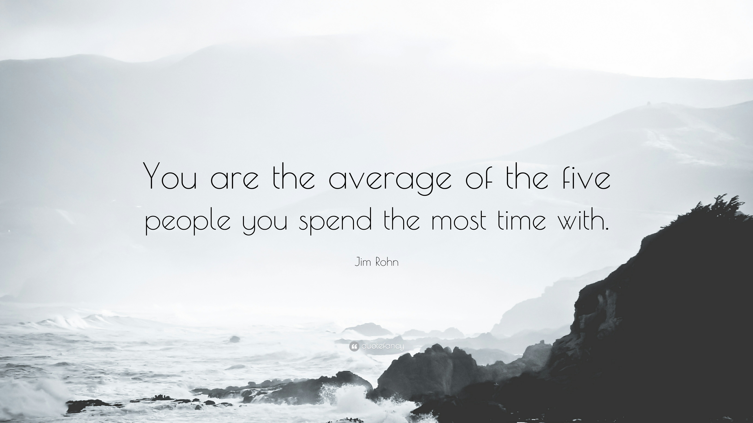

Slide 56
5-step road map for a mindshift
Notes:
There are four key elements to this line crossing journey. They are core values, Life of Pi(e), inner circle and your comfort zone. You should know that any of these four themes can be their own presentation. They are that important. If you are interested to learn more, let me know after the presentation.

Slide 57
Notes:
Whether you are an eagle or a duck, great things never happen in the comfort zone.

Slide 59
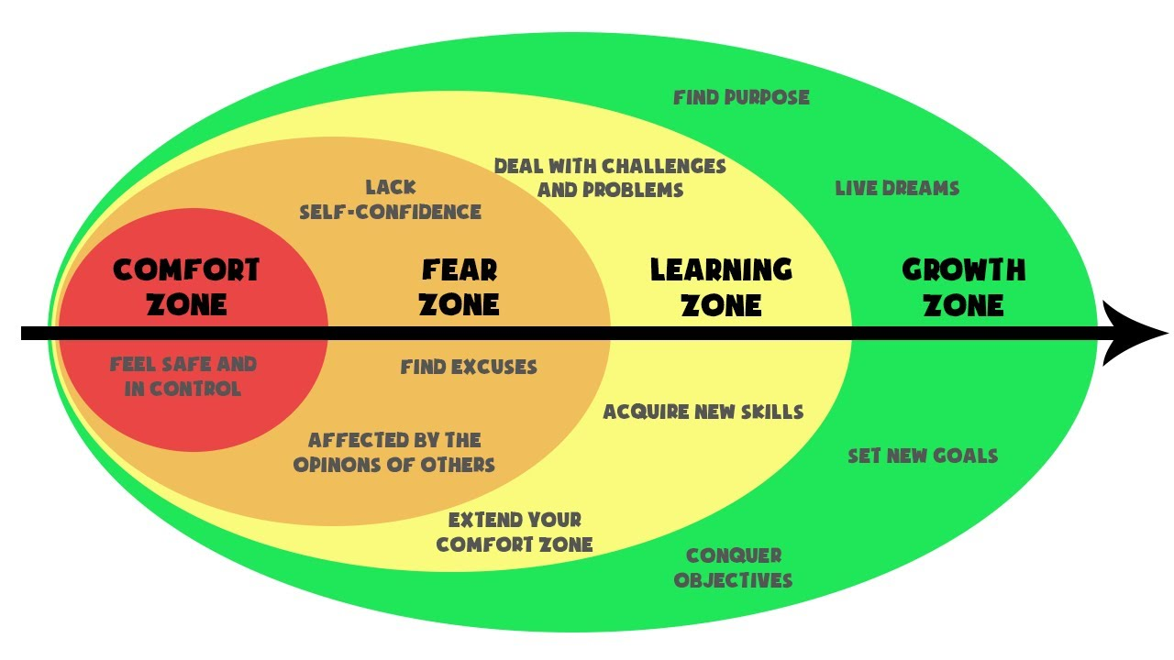
Notes:
Where is your comfort zone? It isn’t as simple as the recliner tipped back watching the Packer game, although that can get pretty comfortable. Think about where you are in your life and where you want to be. Are you challenging and stretching your comfort zone, moving through fear and into learning and growth?

Slide 60
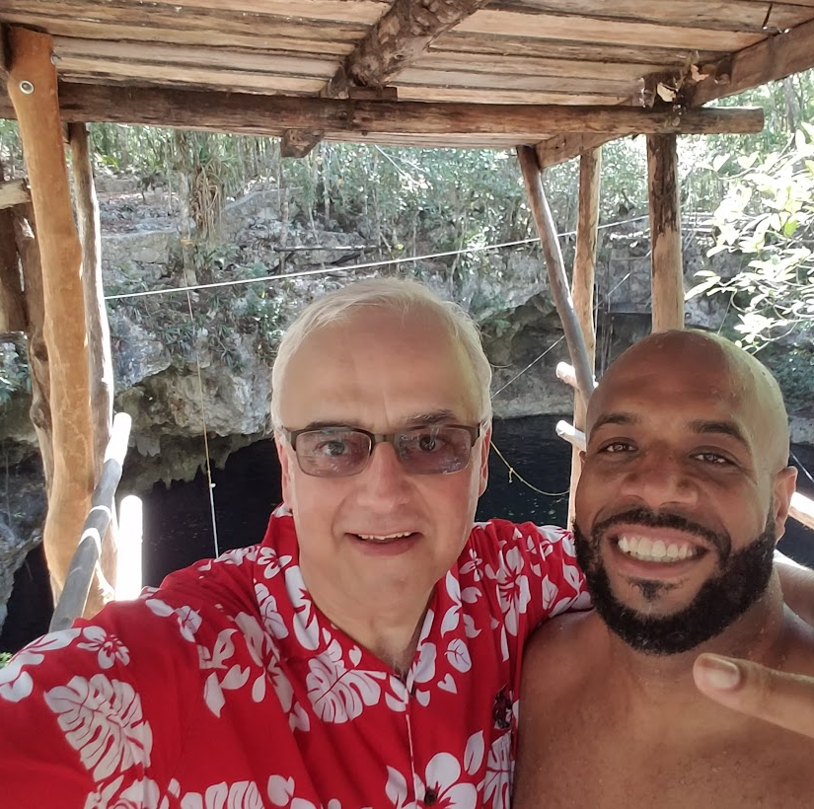
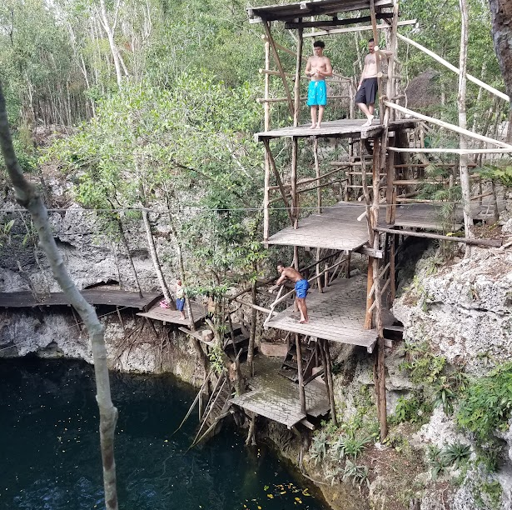

Slide 61
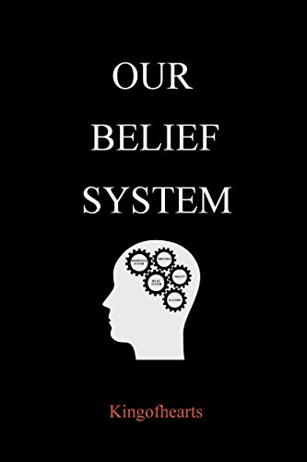

Slide 64
5-step road map for a mindshift
Notes:
There are four key elements to this line crossing journey. They are core values, Life of Pi(e), inner circle and your comfort zone. You should know that any of these four themes can be their own presentation. They are that important. If you are interested to learn more, let me know after the presentation.

Slide 65
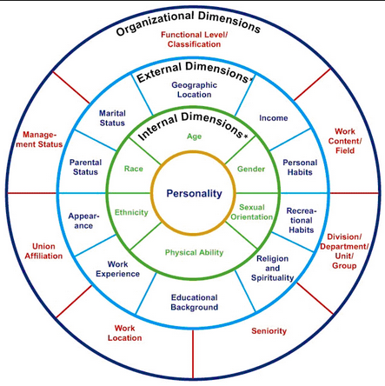
Notes:
As we look deeply into core values and the harmony wheel, we are really looking into our personality. This diagram, which may be hard to read, looks at the influences in your life around your personality. When you look at challenges in your life or your business, you can always peel away the layers of your life to get to personality. If you have an addiction, it starts on the inside with personality. If your sales are down, it boils down to personality. If you family relationships are poor, it comes down to personality.

Slide 66
Notes:
The most effective tool I’ve seen to get to personality and behavior is through the Maxwell DISC behavioral assessment. If you know your strengths and obstacles, as brought out through the harmony wheel and this assessment, you have an advantage in every area of your life. A simple fifteen-minute assessment gives you a thirty-page report that can change your life and business. When we become self-aware, we can fly over fear. I’m an ISC. As you can probably tell, I’m living my core values through my personality—optimism, trust, honesty, enthusiasm and teamwork.

Slide 68
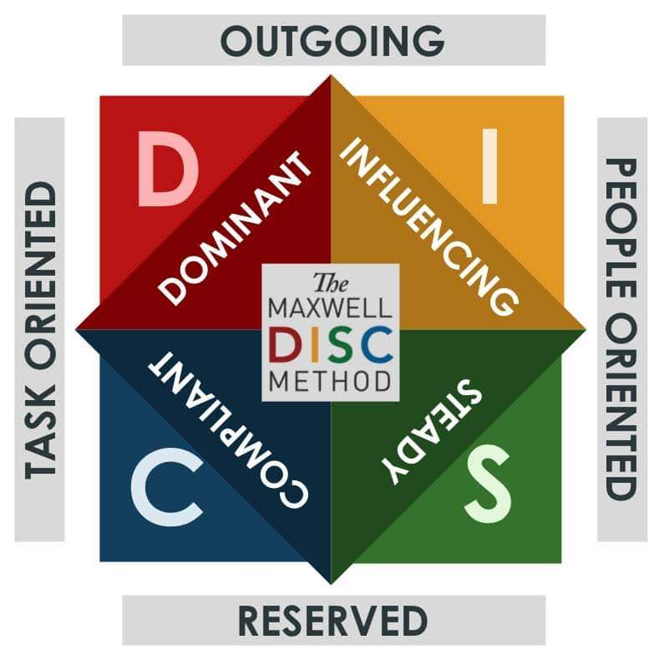

Slide 71
5-step road map for a mindshift
Notes:
There are four key elements to this line crossing journey. They are core values, Life of Pi(e), inner circle and your comfort zone. You should know that any of these four themes can be their own presentation. They are that important. If you are interested to learn more, let me know after the presentation.

Slide 76
What’s next?
Do the multi-switching exercise with friends, family and co-workers
Speak Your Peace
Commit to implementing at least one change from Todd’s Talent Engagement Cycle
Investigate your Core Values
Bring about change with the Wheel of Life
DISC your team
Elevate Employee Engagement Challenge

Slide 77
Special fox valley shrm offer
30 min.=$247 value

Slide 78
Commit

